Slide 1
Splash Screen

Slide 2
Lesson Menu
Then/Now
New Vocabulary
Key Concept: FOIL Method for Multiplying Binomials
Example 1: Write an Equation Given Roots
Concept Summary: Factoring Techniques
Example 2: Factor GCF and by Grouping
Example 3: Perfect Squares and Differences of Squares
Example 4: Factor Trinomials
Key Concept: Zero Product Property
Example 5: Real-World Example: Solve Equations by Factoring

Slide 3
Then/Now
You factored polynomials. (Lesson 0–3)
Write quadratic equations in intercept form.
Solve quadratic equations by factoring.

Slide 4
Vocabulary
factored form
FOIL method

Slide 5
Concept

Slide 6
Example 1
Write an Equation Given Roots
(x – p)(x – q) = 0 Write the pattern.
Replace p with and q with –5.
Simplify.
Use FOIL.

Slide 7
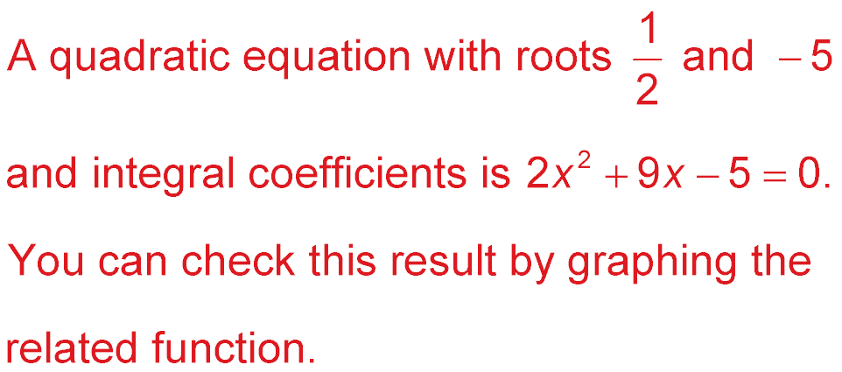
Example 1
Write an Equation Given Roots
Multiply each side by 2 so b and c are integers.
Answer:

Slide 8
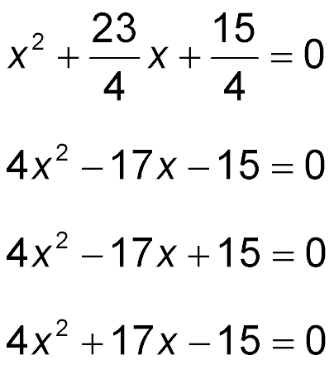
Example 1
A. ans
B. ans
C. ans
D. ans
A
B
C
D

Slide 9
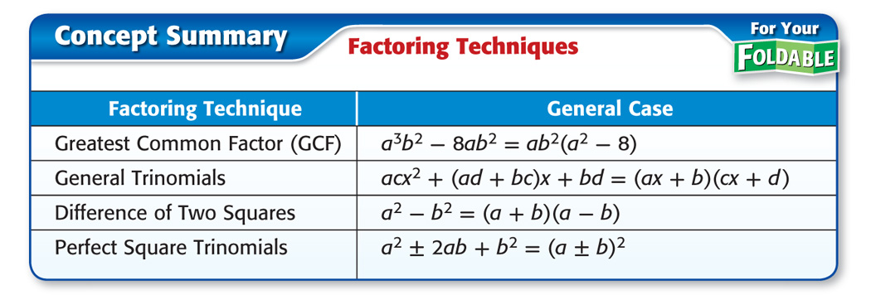
Concept

Slide 10
Example 2
Factor GCF and by Grouping
A. Factor 9y ³ – 6y ² + 3y.
9y ³ – 6y ² + 3y = 3y(3y ²) – 3y(2y) + 3y(1) Factor the GCF.
= 3y(3y ² – 2y + 1) Distributive Property
Answer: 3y(3y ² – 2y + 1)

Slide 11
Example 2
Factor GCF and by Grouping
B. Factor 8a² + 10ab² + 4ab + 5b³.
8a² + 10ab² + 4ab + 5b³ = (8a² + 4ab) + (10ab² + 5b³) Group terms with common factors.
= 4a(2a + b) + 5b²(2a + b) Factor the GCF from each group.
= (4a + 5b²)(2a + b) Distributive Property
Answer: (4a + 5b²)(2a + b)

Slide 12
Example 2
A. Factor 24b³ – 18b² + 18b.
A. 6b(6b² + 3b + 3)
B. 4b(6b² – 4b + 4)
C. 6b(4b² – 3b + 3)
D. 12b(2b² – b + 1)
A
B
C
D

Slide 13
Example 2
B. Factor 6p² – 3pr² + 8pr – 4r³.
(3p – 4r)(2p – r ²)
(4p + 3r)(2p – r ²)
(4p + 3r)(2p + 3r ²)
D. (3p + 4r)(2p – r ²)
A
B
C
D

Slide 14
Example 3
Perfect Squares and Differences of Squares
A. Factor x ² + 10x + 25.
x ² = (x)²; 25 = 5² First and last terms are perfect squares.
10x = 2(x)(5) Middle term equals 2ab.
x ² + 10x + 25 is a perfect square trinomial.
x ² + 10x + 25 = (x + 5)² Factor using the pattern.
Answer: (x + 5)²

Slide 15
Example 3
Perfect Squares and Differences of Squares
B. Factor 12b⁸ – 27c ².
12b⁸ – 27c ² = 3(4b⁸ – 9c ²) Factor the GCF.
= 3[(2b⁴)² – (3c)²] Write in form a² – b².
= 3(2b⁴ + 3c)(2b⁴ – 3c) Factor the difference of squares.
Answer: 3(2b⁴ + 3c)(2b⁴ – 3c)

Slide 16
Example 3
A. Factor z ² + 12z + 36.
A. (z + 6)²
B. (z + 3)²
C. (z – 9)²
D. (z + 12)²
A
B
C
D

Slide 17
Example 3
B. Factor 18d ⁶ – 50f ².
A. 2(3d ³ – 5f)(3d ³ – 5f)
B. 2(3d ³ + 5f)(3d ³ – 5f)
C. 2(9d ³ + 25f)(9d ³ – 25f)
D. 2(3d ³ + 5f ²)(3d ³ – 5f ²)
A
B
C
D

Slide 18
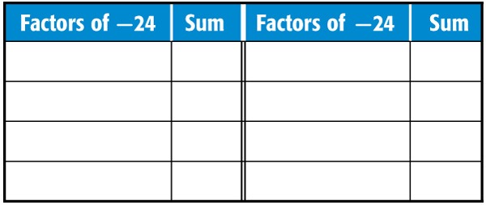
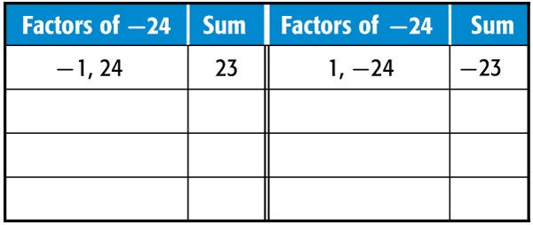
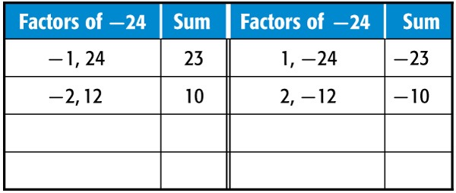
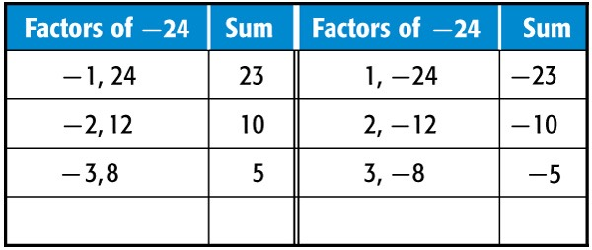
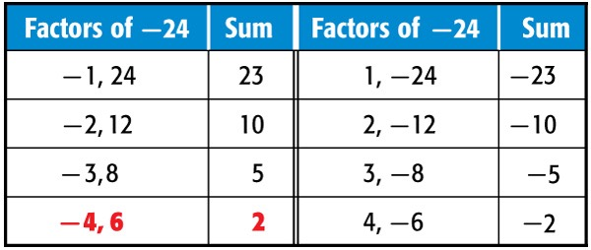
Example 4
Factor Trinomials
A. Factor x ² + 2x – 24.
Find two values, m and p, such that their product equals ac and their sum equals b.
b = 2
ac = –24 a = 1, c = –24

Slide 19
Example 4
Factor Trinomials
x ² + 2x – 24 Original expression
= x ² + mx + px – 24 Write the pattern.
= x ² + 6x + (–4x) – 24 m = 6, p = –4
= (x ² + 6x) + (–4x – 24) Group terms with common factors.
= x(x + 6) – 4(x + 6) Factor the GCF from each grouping.
= (x + 6)(x – 4) Distributive Property
Answer: (x + 6)(x – 4)

Slide 20
Example 4
Factor Trinomials
B. Factor 2y ² – 9y – 18.
ac = –36 a = 2, c = –18
2y ² – 9y – 18 Original expression
= 2y ² – my + py – 18 Write the pattern.
= 2y ² – 12y + 3y – 18 m = –12, p = 3
= (2y ² – 12y) + (3y – 18) Group terms with common factors.
= 2y(y – 6) + 3(y – 6) Factor the GCF from each grouping.
= (2y + 3)(y – 6) Distributive Property
Answer: (2y + 3)(y – 6)

Slide 21
Example 4
A. Factor x ² – 8x + 15.
A. (x + 3)(x + 5)
B. (x – 4)(x + 2)
C. (x + 7)(x + 8)
D. (x – 3)(x – 5)
A
B
C
D

Slide 22
Example 4
B. Factor 3s ² – 11s – 4.
A. (3s + 1)(s – 4)
B. (s + 1)(3s – 4)
C. (3s + 4)(s – 1)
D. (s – 1)(3s + 4)
A
B
C
D

Slide 23
Concept

Slide 24
Example 5
Solve Equations by Factoring
ARCHITECTURE The entrance to an office building is an arch in the shape of a parabola whose vertex is the height of the arch. The height of the arch is given by h = 9 – x ², where x is the horizontal distance from the center of the arch. Both h and x are measured in feet. How wide is the arch at ground level?
To find the width of the arch at ground level, find the distance between the two zeros.

Slide 25
Example 5
Solve Equations by Factoring
9 – x ² = 0 Original expression
x ² – 9 = 0 Multiply both sides by –1.
(x + 3)(x – 3) = 0 Difference of squares
x + 3 = 0 or x – 3 = 0 Zero Product Property
x = –3 x = 3 Solve.
Answer: The distance between 3 and – 3 is 3 – (–3) or 6 feet.

Slide 26
Example 5
Solve Equations by Factoring
Check 9 – x ² = 0
?
?
9 – (3)² = 0 or 9 – (–3)² = 0
?
?
9 – 9 = 0 9 – 9 = 0
✓
✓
0 = 0 0 = 0

Slide 27
Example 5
TENNIS During a match, Andre hit a lob right off the court with the ball traveling in the shape of a parabola whose vertex was the height of the shot. The height of the shot is given by h = 49 – x ², where x is the horizontal distance from the center of the shot. Both h and x are measured in feet. How far was the lob hit?
A
B
C
D
A. 7 feet
B. 11 feet
C. 14 feet
D. 25 feet

Slide 28
End of the Lesson

